Slide 1
Data visualization presentation
- Zaheen Choudhary

Slide 2
What is Data? Why do we need to represent data?
Data is a collection of different pieces of information or facts which, if used efficiently helps us to derive logical outcomes.
Data is something which can be examined, assessed and interpreted which in turn helps us to develop an understanding of a situation, monitor a trend and predict future events.
We create representations to shape the information we receive from the data in order to make “efficient” decisions. It helps us to convert numbers and letters into pleasing visuals thereby, saving time.
A good representation of data helps to break the complex data problems and arrive at a conclusion that is easy to understand.

Slide 3
What are the factors which influence HOW SHOULD WE REPRESENT?
Volume of the data
Variables (string/categorical and numeric)
Question attempting to answer through visualization
Who will be viewing the data?
How can the data narrative be best optimized through design?

Slide 5

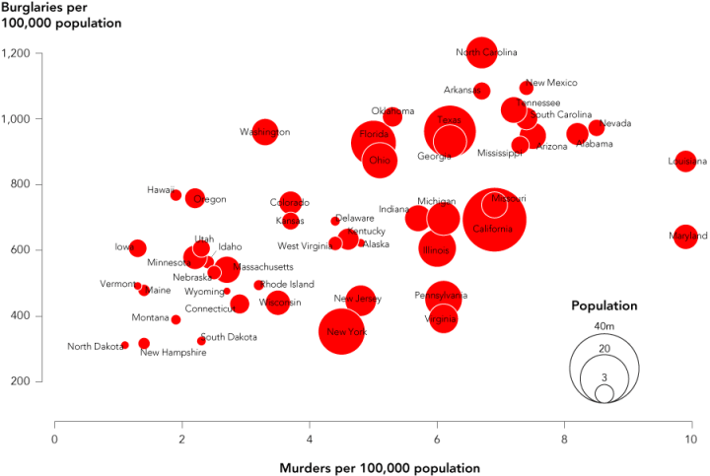
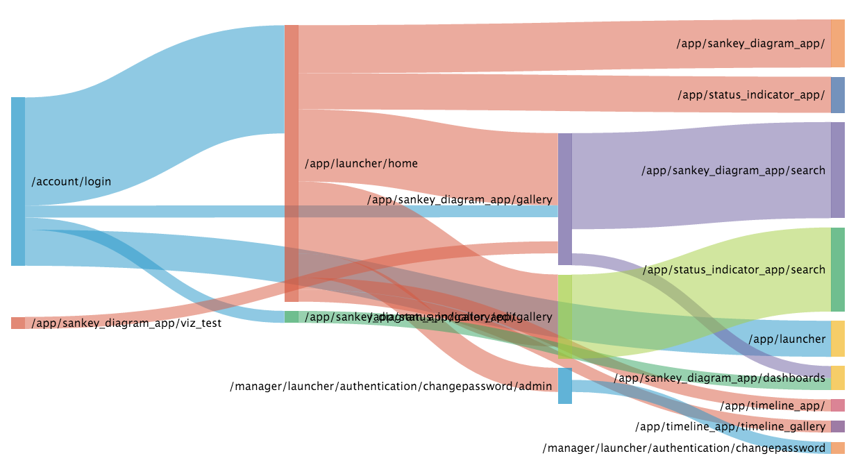

Slide 6
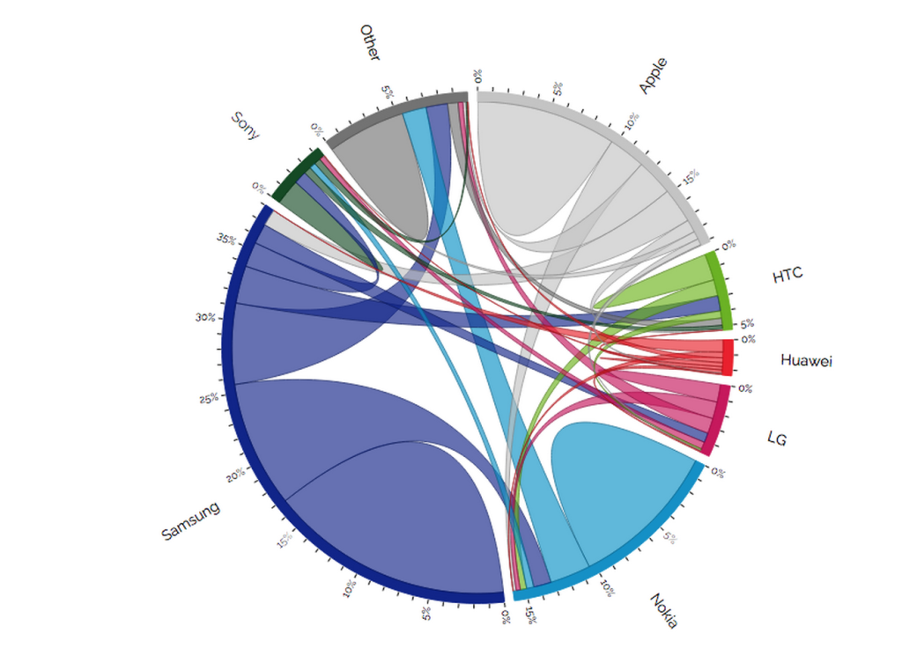
CHORD DIAGRAM/ RADIAL NETWORK DIAGRAM

Slide 7
Apple and Samsung are capturing users from mainly Nokia and Other
Apple is losing few users, except to Samsung; even so, the number gained is twice the number lost
HTC is acquiring users from Nokia and LG, yet losing users to Samsung and Huawei
Nokia is still acquiring more users from Other than it loses
Huawei stands out as a new brand that is gaining small numbers of users from all brands, particularly Samsung.

